Slide 1


GTX2-Local-Build Quick Build
Miracle Dsouza
Rahul Dcosta
Associate Developer
Associate Developer
28 – 09 - 2017
Notes:
SHORT TITLE

Slide 2
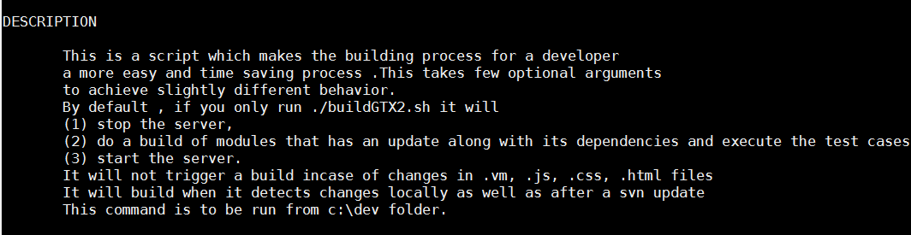
All About Quick Build

Slide 3

Commands

Slide 4
Few test scenarios - Current v/s New Solution build time
Time comparisons

Slide 5
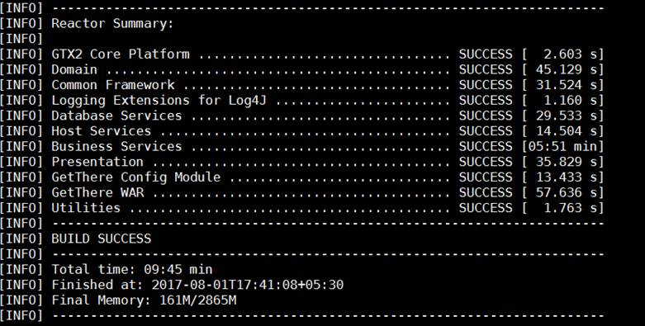
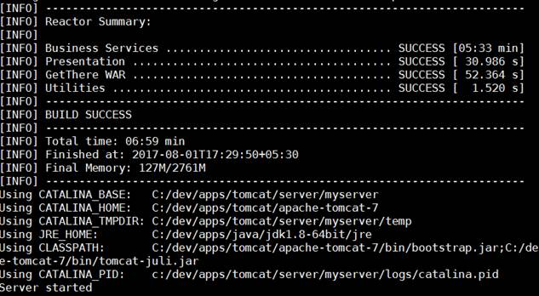
Time difference for changes in a java file (bizsvc) – with skipT
Classic way
New way
Time saved 2:46mins + 10 sec of transitioning = 2:56mins

Slide 6
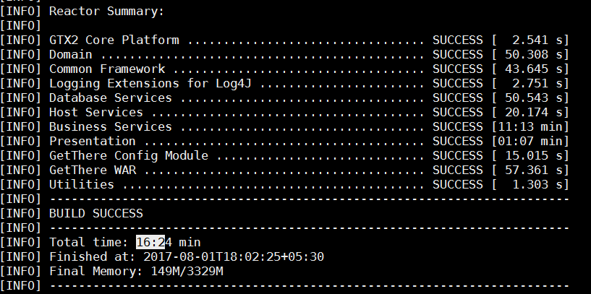
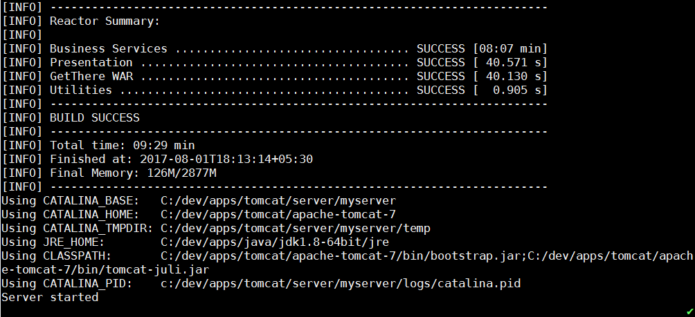
Time difference for changes in a java file (bizsvc) – without skipT
Classic way
New way
Time saved 7:35mins + 10 sec of transitioning = 7:45mins

Slide 7
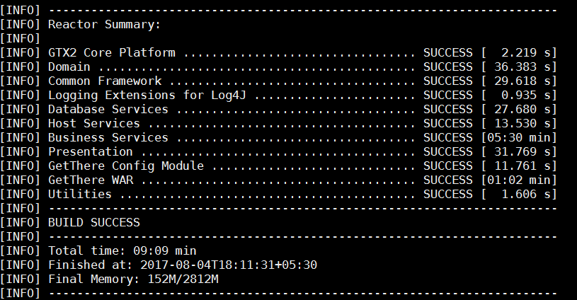
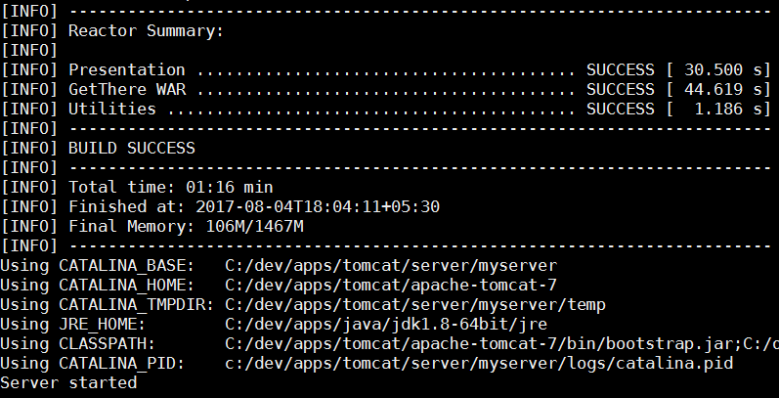
Time difference for changes in a java file (!bizsvc) – with skipT
Classic way
New way
Time saved 8:33mins+10sec of transitioning = 8:43mins

Slide 8
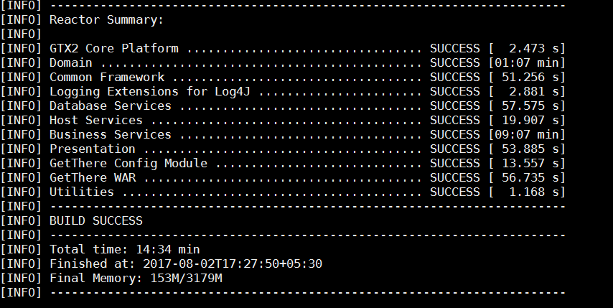
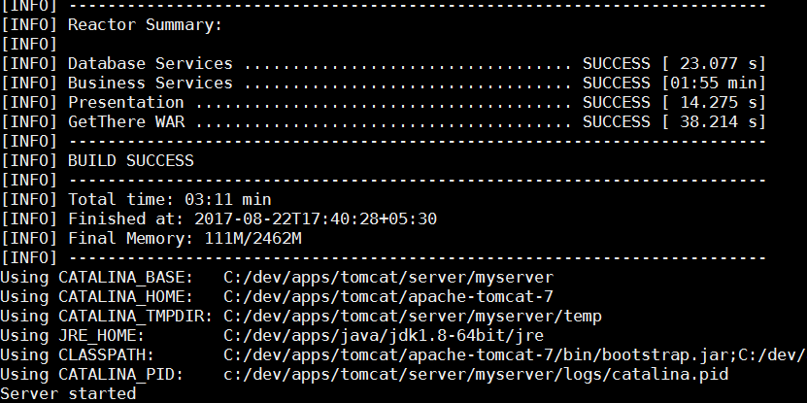
Time difference for changes in a java file (!bizsvc) – without skipT
Classic way
New way
Time saved 11.23 mins + 10 sec of transitioning =11.33mins

Slide 9
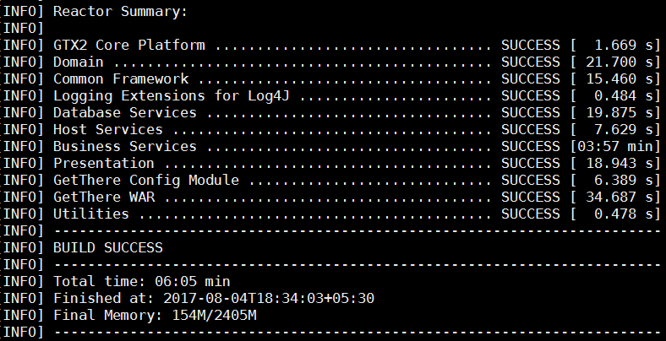
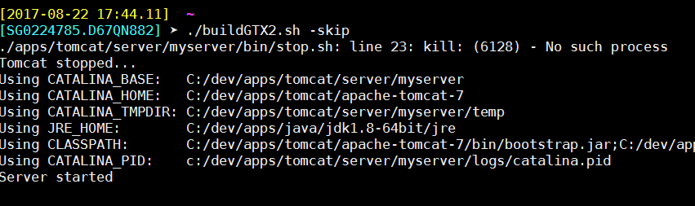
Changes in .vm file (No Build Runs ☺ )
Classic Way
New way
Time saved 6mins+10sec of transitioning = 6:10mins

Slide 10
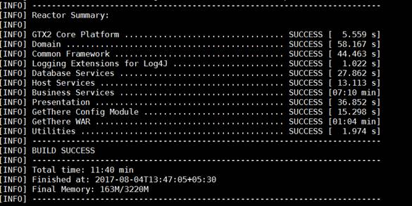
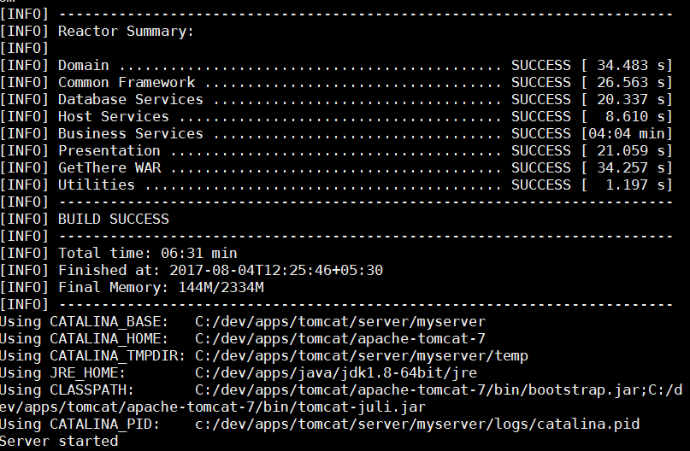
Build after svn update with skipT
Classic way
New way
Time saved 5:09mins+10sec = 5:19mins

Slide 11
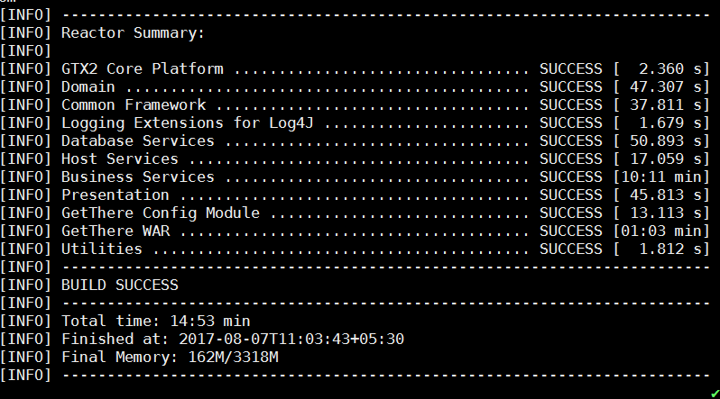
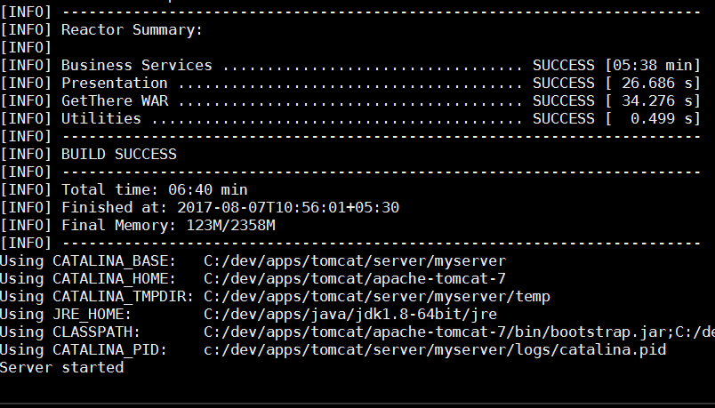
Build after svn update without skipT
Classic way
New way
Time saved 8.13mins+10sec = 8:23mins

Slide 12
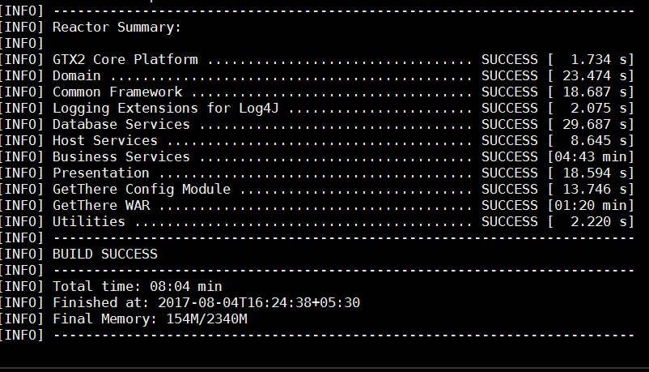
Build after a previous build – no change(No Build Runs ☺ )
Classic way
New way
Time saved 8.04 mins+10sec of transitioning =8.14mins

Slide 13
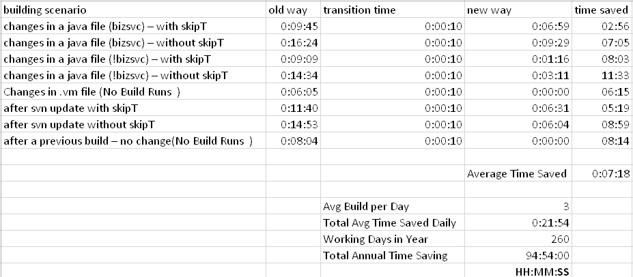
Summary of time saved

Slide 14
DEMO

Slide 15
Summary
No build if no update
No build in case of UI changes
Build only the folder/s in which change/s is made and its dependencies
Works for local changes as well as after update from svn
Decision Parameter supported to skip tests or do a complete build and control server start
Script to be run from dev folder
Configurable gtx2 path from properties file in dev folder
Command to execute
./buildGTX2.sh -> One command to stop server, do a mvn clean, a mvn build & start server
./buildGTX2.sh –skipT -> to skip tests
./buildGTX2.sh –skipS -> to skip start of server
./buildGTX2.sh –help -> to provide description and usage guidelines

Slide 16
We are more than happy to work on any suggestions you may have!!! This is just the beginning! Thank you!!

